Slide 1


Electric Circuits
Twelfth Edition, Global Edition
Chapter 7 – Part 1
Response of First-Order R L and R C Circuits
© 2024 Pearson Education Ltd. All Rights Reserved.
Notes:
If this PowerPoint presentation contains mathematical equations, you may need to check that your computer has the following installed:
1) Math Type Plugin
2) Math Player (free versions available)
3) NVDA Reader (free versions available)

Slide 2
Chapter 7 – Response of First-Order R L/R C Circuits
Objectives:
7.1 Natural response of R L/R C circuits
7.2 Step response of R L/R C circuits
7.3 Sequential switching in first-order circuits
7.4 Unbounded response
7.5 Integrating amplifier

Slide 3
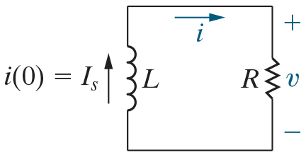


Chapter 7 – R L Natural Response (1 of 7)
The problem: Given an initial current i(0) through L at t = 0,
find i(t) for
Note: this is the “natural” response of this circuit because for
there is no independent source in the circuit – the
response is due only to the “nature” of the components and their interconnection.

Slide 4
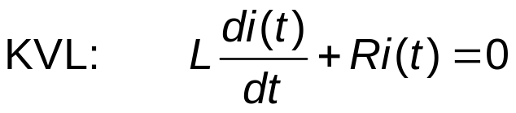
Chapter 7 – R L Natural Response (2 of 7)
This equation is a
  First-order (the highest derivative is a first derivative)
  Homogeneous (the right-hand side is 0)
  Ordinary differential equation
  With constant coefficients

Slide 5
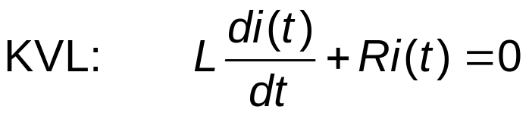



Chapter 7 – R L Natural Response (3 of 7)
The solution to the differential equation, repeated below, must be a function whose first-derivative has the same form as the function. Which one of these functions exhibits this behavior?
A.
B.
C.

Slide 6


Chapter 7 – R L Natural Response (3 of 7)
The solution to the differential equation, repeated below, must be a function whose first-derivative has the same form as the function. Which one of these functions exhibits this behavior?
A.
B.
C.

Slide 7

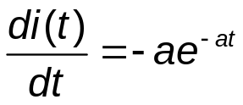










Chapter 7 – R L Natural Response (4 of 7)
Let
and
Substituting,
Rearranging,
so
Solving,
But
so
Check:
Notes:
Long Description:
L Open Parenthesis negative R divided by L Close Parenthesis multiplied by I subscript S baseline e to the negative Open Parenthesis R divided by L Close Parenthesis t power plus R I subscript S Baseline e to the negative Open Parenthesis R divided by L Close Parenthesis t power.

Slide 8

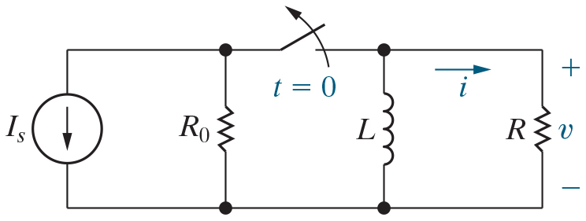
Chapter 7 – R L Natural Response (5 of 7)
Here is one circuit that can be used to establish the initial
current through the inductor. For
the inductor can be
replaced by
A. An open circuit
B. A short circuit
C. A resistor

Slide 9
Chapter 7 – R L Natural Response (5 of 7)
Here is one circuit that can be used to establish the initial
current through the inductor. For
the inductor can be
replaced by
A. An open circuit
B. A short circuit
C. A resistor

Slide 10



Chapter 7 – R L Natural Response (6 of 7)
To evaluate the current in the inductor for
close the
switch and replace the inductor with a short circuit. The current from bottom to top in the short circuit is
A.
B.
C.

Slide 11
Chapter 7 – R L Natural Response (6 of 7)
To evaluate the current in the inductor for
close the
switch and replace the inductor with a short circuit. The current from bottom to top in the short circuit is
A.
B.
C.

Slide 12

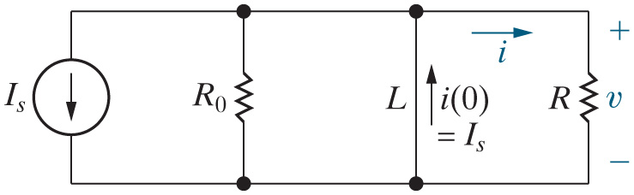
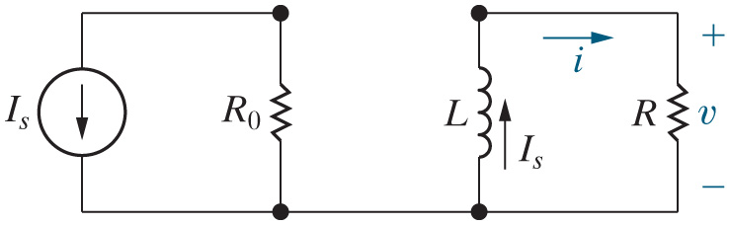



Chapter 7 – R L Natural Response (7 of 7)

Slide 13
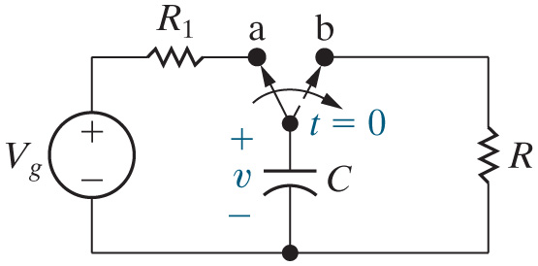


Chapter 7 – R C Natural Response (1 of 5)
The problem: Find v(t) for
Note that the circuit to the
left of the capacitor establishes an initial voltage drop v(0)
across C at

Slide 14


Chapter 7 – R C Natural Response (2 of 5)
Here is the circuit for the R C natural response problem. For
the capacitor can be replaced by
A. An open circuit
B. A short circuit
C. A constant current

Slide 15
Chapter 7 – R C Natural Response (2 of 5)
Here is the circuit for the R C natural response problem. For
the capacitor can be replaced by
A. An open circuit
B. A short circuit
C. A constant current

Slide 16




Chapter 7 – R C Natural Response (3 of 5)
To evaluate the voltage drop across the capacitor for
put the switch in the “a” position and replace the capacitor with an open circuit. The voltage drop across the open circuit, positive at the top, is
A.
B.
C.

Slide 17
Chapter 7 – R C Natural Response (3 of 5)
To evaluate the voltage drop across the capacitor for
put the switch in the “a” position and replace the capacitor with an open circuit. The voltage drop across the open circuit, positive at the top, is
A.
B.
C.

Slide 18
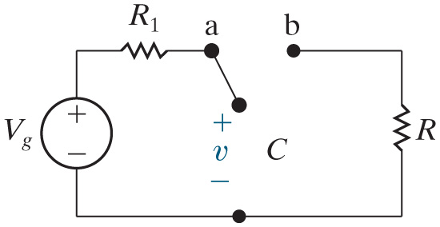





Chapter 7 – R C Natural Response (4 of 5)
There is an open circuit here, so the current in this circuit is 0, and
0, and the voltage drop across
is 0. Thus,
Remember the continuity requirement for capacitors – the voltage drop across the capacitor must be continuous everywhere, so that the current through the capacitor remains finite. Thus,

Slide 19
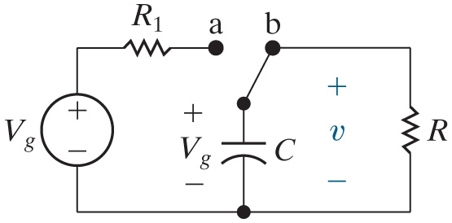

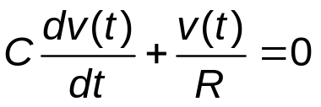

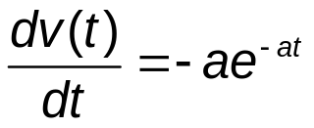







Chapter 7 – R C Natural Response (5 of 5)
K C L:
Let
and
Substituting,
Rearranging,
so
Solving,
But
so

Slide 20

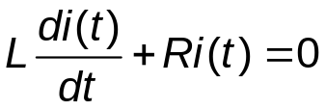







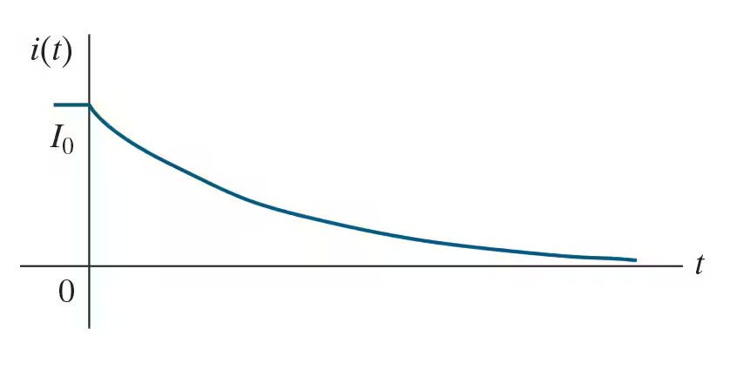
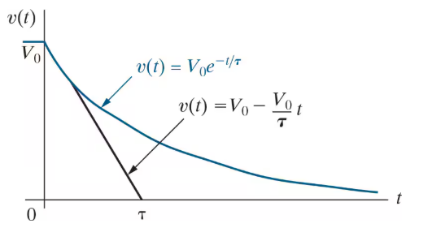


K V L:
K C L:
The form of the natural response is the same:
I C is the initial condition and
is the time constant, a measure of how quickly
or slowly the exponential decays.

Slide 21



Chapter 7 – R L/R C Natural Response (2 of 3)
The form of the R L/R C natural response is
The units for the time constant,
must be
A. s (seconds)
B.
(inverse seconds)
C.
has no units

Slide 22
Chapter 7 – R L/R C Natural Response (2 of 3)
The form of the R L/R C natural response is
The units for the time constant,
must be
A. s (seconds)
B.
(inverse seconds)
C.
has no units

Slide 23


Chapter 7 – R L/R C Natural Response (3 of 3)
The R L natural response is
Therefore, the time constant,
for the R L circuit is
A. R/L
B. (L/R)t
C. (L/R)

Slide 24
Chapter 7 – R L/R C Natural Response (3 of 3)
The R L natural response is
Therefore, the time constant,
for the R L circuit is
A. R/L
B. (L/R)t
C. (L/R)

Slide 25

Copyright
This work is protected by United Kingdom copyright laws and is provided solely for the use of instructors in teaching their courses and assessing student learning. Dissemination or sale of any part of this work (including on the World Wide Web) will destroy the integrity of the work and is not permitted. The work and materials from it should never be made available to students except by instructors using the accompanying text in their classes. All recipients of this work are expected to abide by these restrictions and to honor the intended pedagogical purposes and the needs of other instructors who rely on these materials.

